Slide 1
CSC 250: Foundations of Computer Science I
Fall 2023 - Lecture 8
Amitabha Dey
Department of Computer Science
University of North Carolina at Greensboro

Slide 2
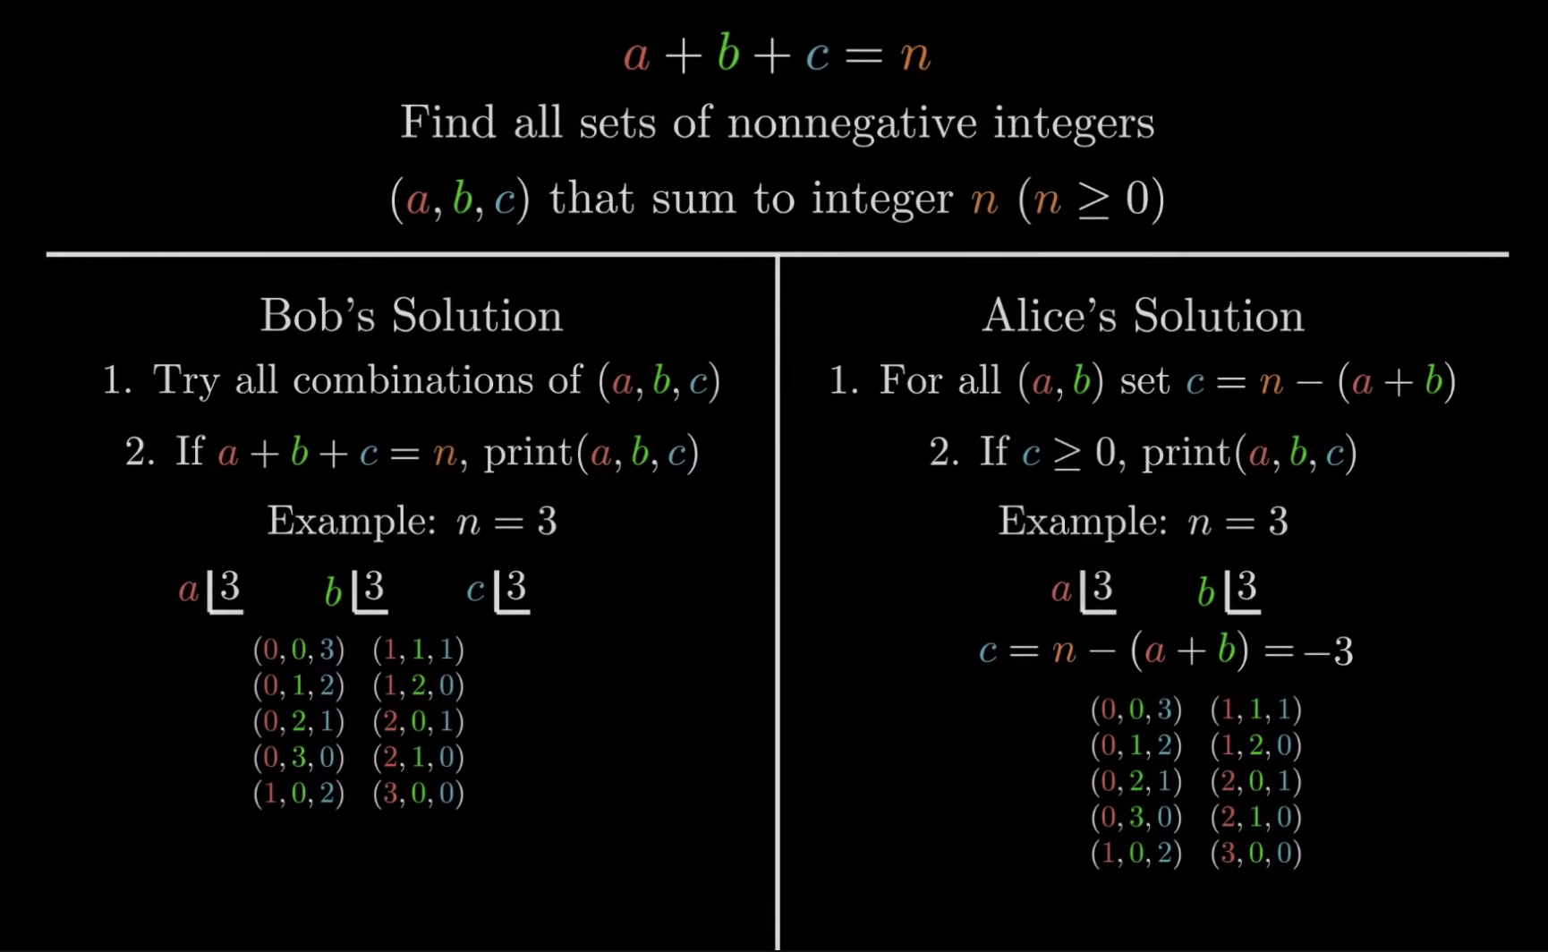
How to measure algorithm efficiency?
Both Bob and Alice try to solve the problem and present their solution.
Bob tries every combination of a, b, and c and whenever their sum is n, he prints it out.
Alice tries to solve the problem in another way. Since the value of n is given to us, she tries every combination of a and b up to n, and then for every combination set c as n - (a+b).
If c value is non-negative, she finds all the valid combination.
Image credit - Reducible @ YouTube

Slide 3
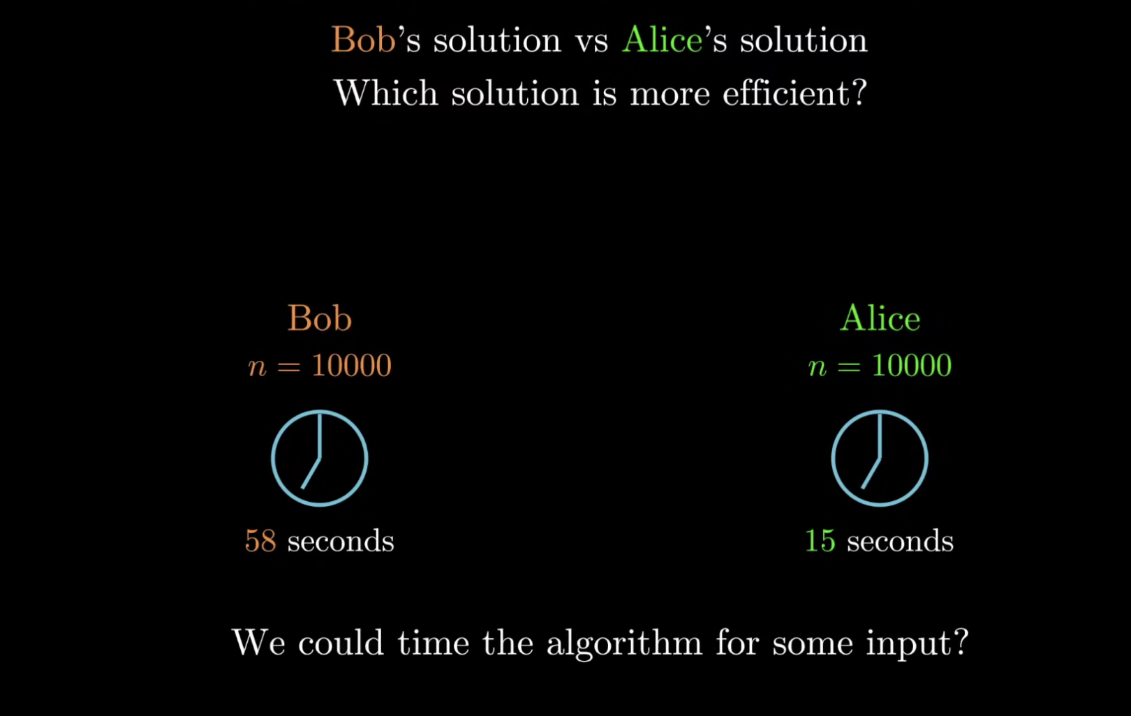
How to measure algorithm efficiency?
How do we objectively define which student has the better algorithm?
The simplest idea would be to physically time each of the algorithm for a particular input.
Let’s say in a particular computer, Bob’s algorithm ran for 58 seconds, while Alice’s algorithm ran for 15 seconds.
Image credit - Reducible @ YouTube

Slide 4
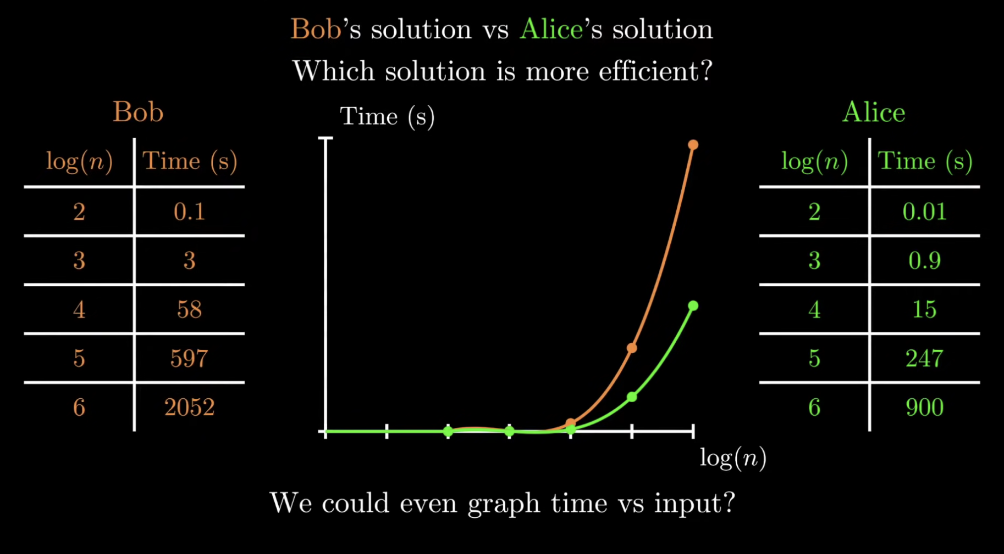
How to measure algorithm efficiency?
We could put these values in a graph and see approximately how the time grows as a function of the input.
We could standardize x-axis on a logarithmic scale.
It’s visible that Alice’s solution is better than Bob’s.
Image credit - Reducible @ YouTube

Slide 5
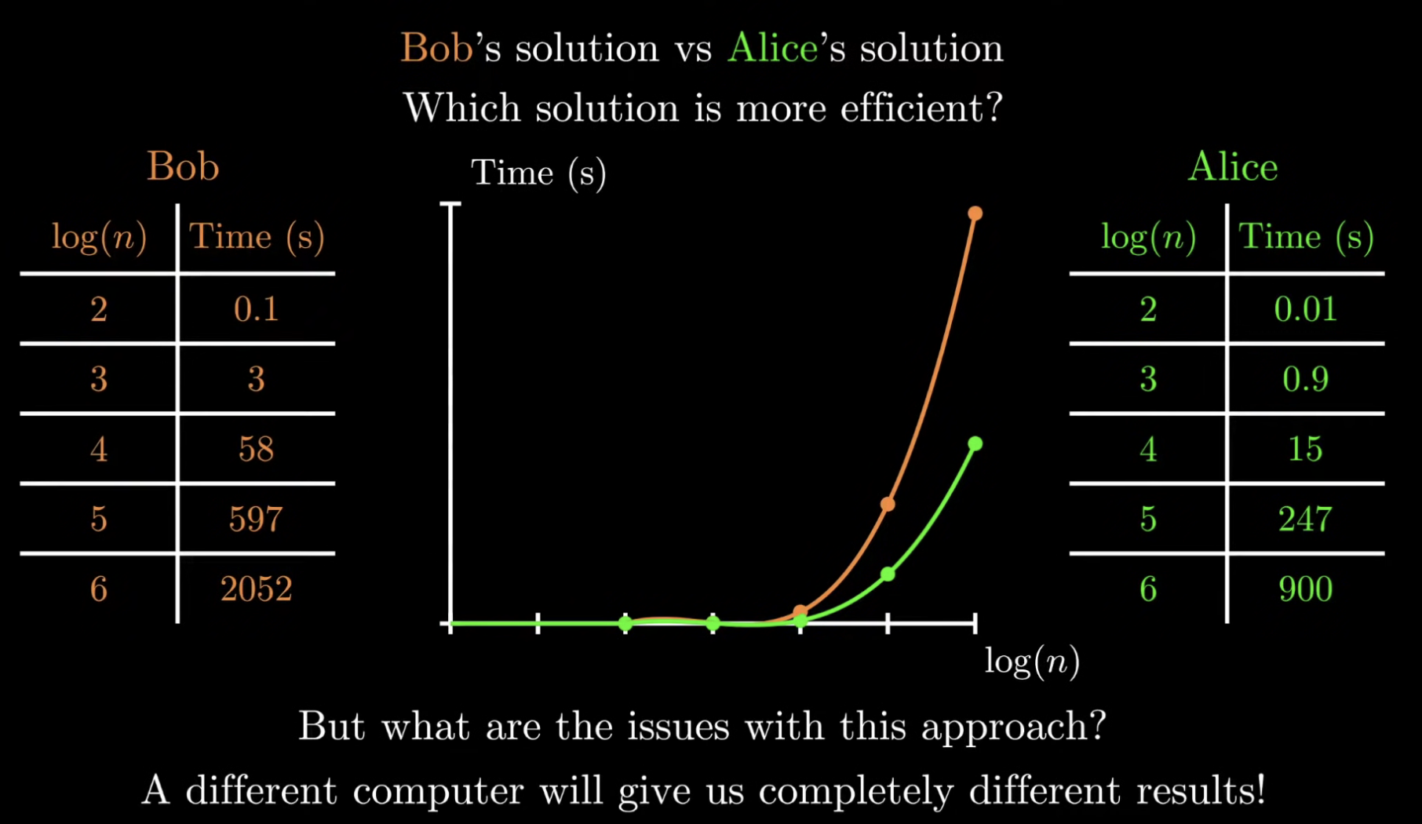
How to measure algorithm efficiency?
All these time measurements are taken on a specific computer. On a different computer, all the data points could look totally different.
Machine dependence
A true and pure efficiency measurement should be Machine independent! We want to be able to tell how fast the algorithm is regardless of what machine it runs on.
Image credit - Reducible @ YouTube

Slide 6
How to measure algorithm efficiency?
Machine Independent
The evaluation of efficiency should be as machine independent as possible.
It is not useful to measure how fast the algorithm runs as this depends on which particular computer, OS, programming language, compiler, and kind of inputs are used in testing
Instead,
we count the number of basic operations the algorithm performs.
we calculate how this number depends on the size of the input.
A basic operation is an operation which takes a constant amount of time to execute.
Hence, the efficiency of an algorithm is the number of basic operations it performs. This number is a function of the input size n.
All these time measurements are taken on a specific computer. On a different computer, all the data points could look totally different.
Machine dependence
A true and pure efficiency measurement should be Machine independent! We want to be able to tell how fast the algorithm is regardless of what machine it runs on.
Image credit - Reducible @ YouTube

Slide 7
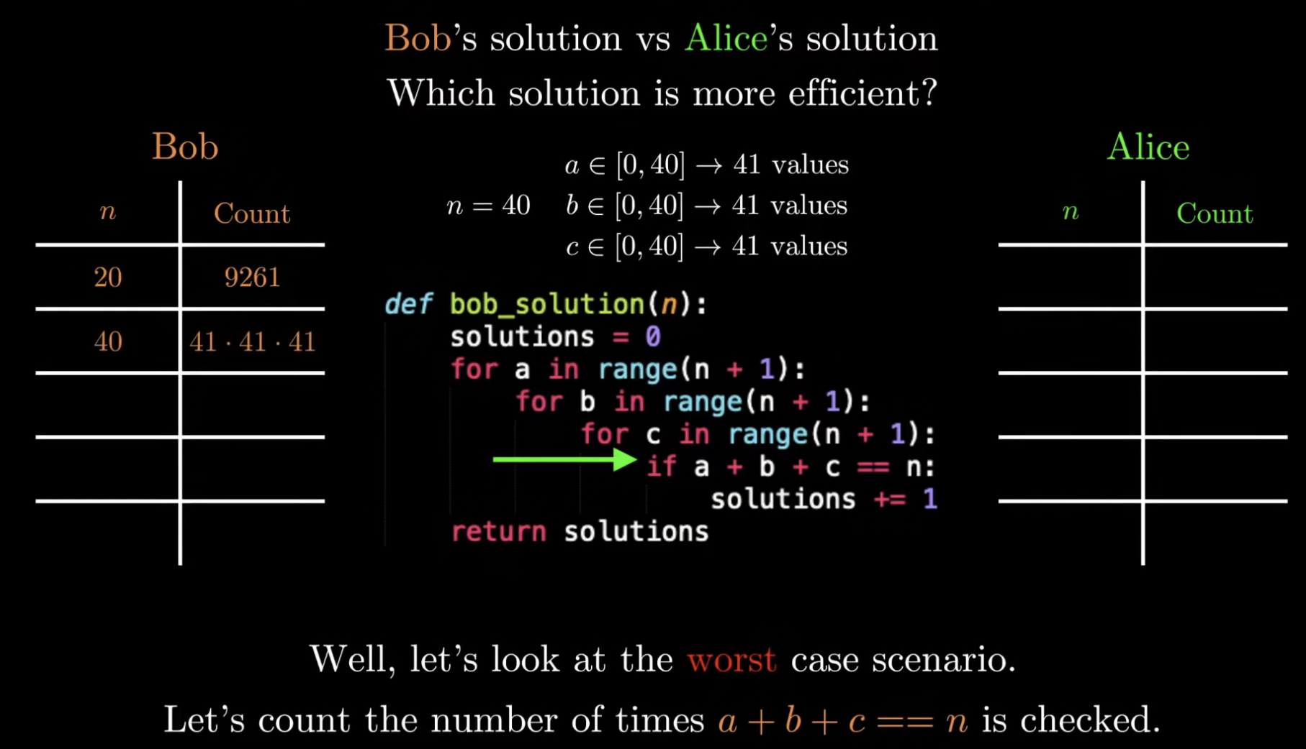
How to measure algorithm efficiency?
One machine independent way is to count the operations in the program and see how it changes as the input increases.
We want to focus on the worst-case scenario for good representation.
Let’s say n = 20.
In Bob’s program, we can look at the if statements, and three for loops and inspect how many times it runs.
Image credit - Reducible @ YouTube

Slide 8
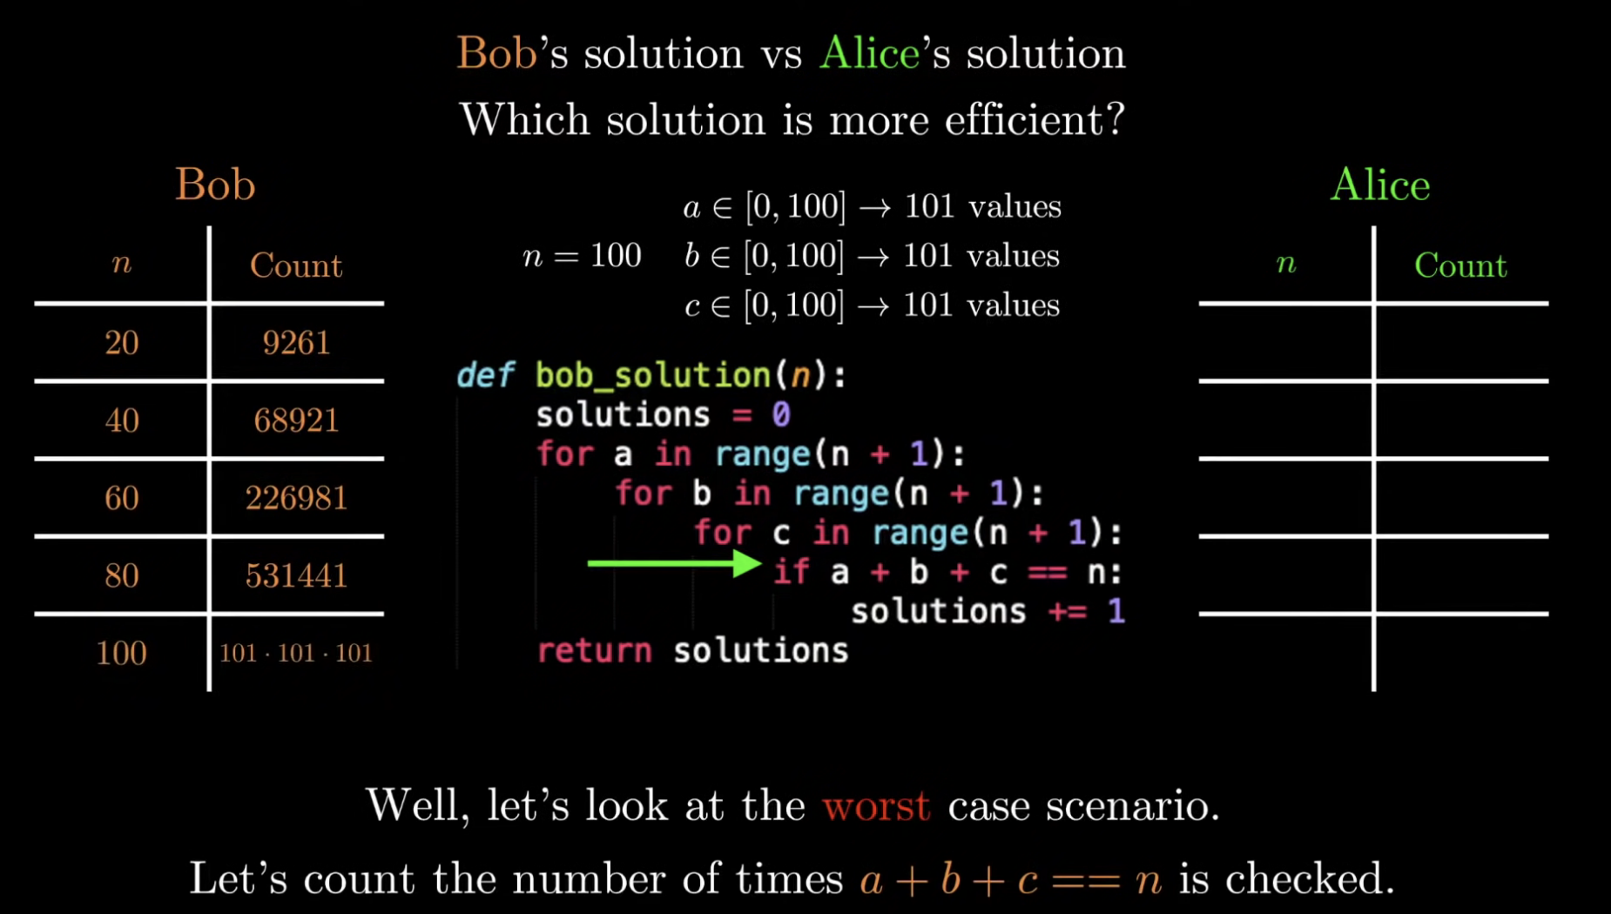
How to measure algorithm efficiency?
One machine independent way is to count the operations in the program and see how it changes as the input increases.
We want to focus on the worst-case scenario for good representation.
Let’s say n = 20.
In Bob’s program, we can look at the if statements, and three for loops and inspect how many times it runs.
Image credit - Reducible @ YouTube

Slide 9
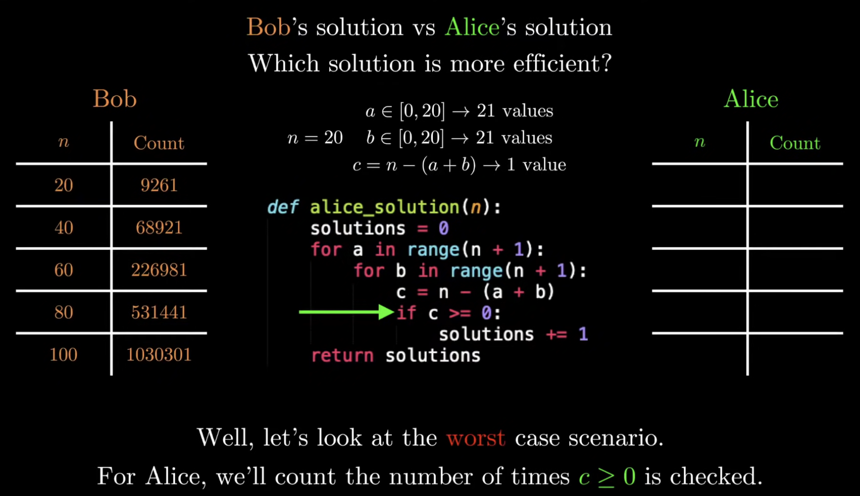
How to measure algorithm efficiency?
The defining characteristic about Alice’s program is that for each pair of a and b, we have exactly one c value.
Image credit - Reducible @ YouTube

Slide 10
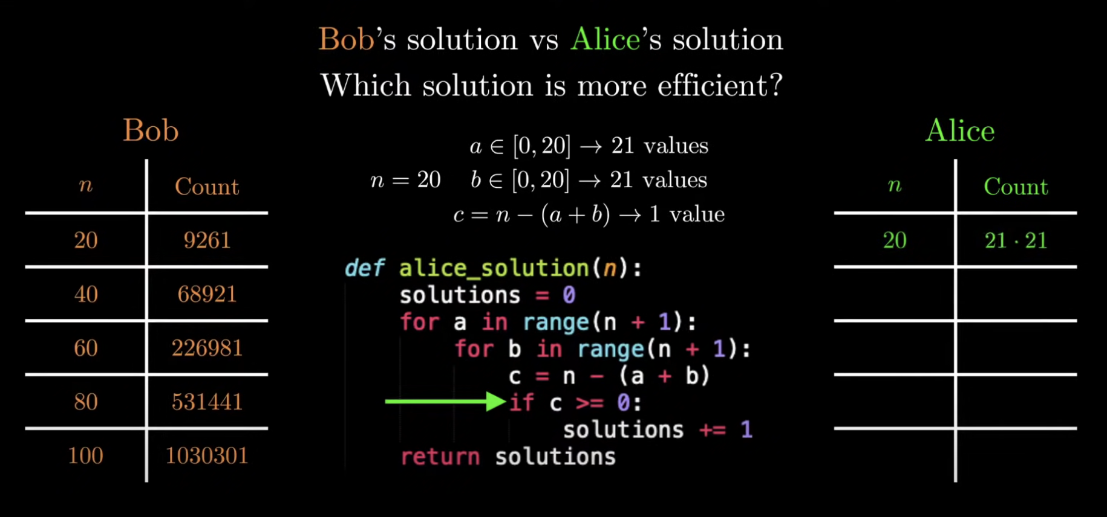
How to measure algorithm efficiency?
The defining characteristic about Alice’s program is that for each pair of a and b, we have exactly one c value.
Image credit - Reducible @ YouTube

Slide 11
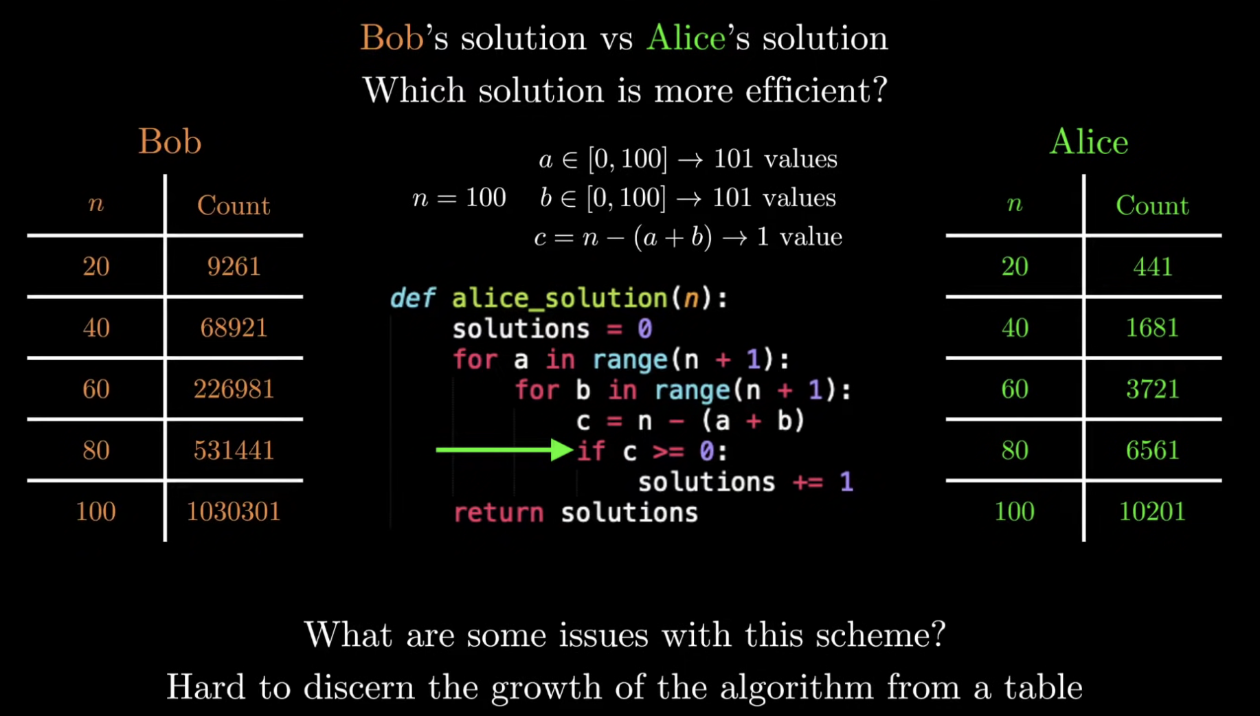
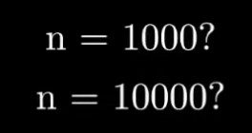
How to measure algorithm efficiency?
What we like about measuring the efficiency of algorithm this way is that it is completely machine independent.
Even in a supercomputer, this counts are not going to change.
One issues with this way is that we don’t have a sense of how the algorithm grows as the input increases.
It’s hard to make an estimate by looking at the table of counts.
Image credit - Reducible @ YouTube

Slide 12
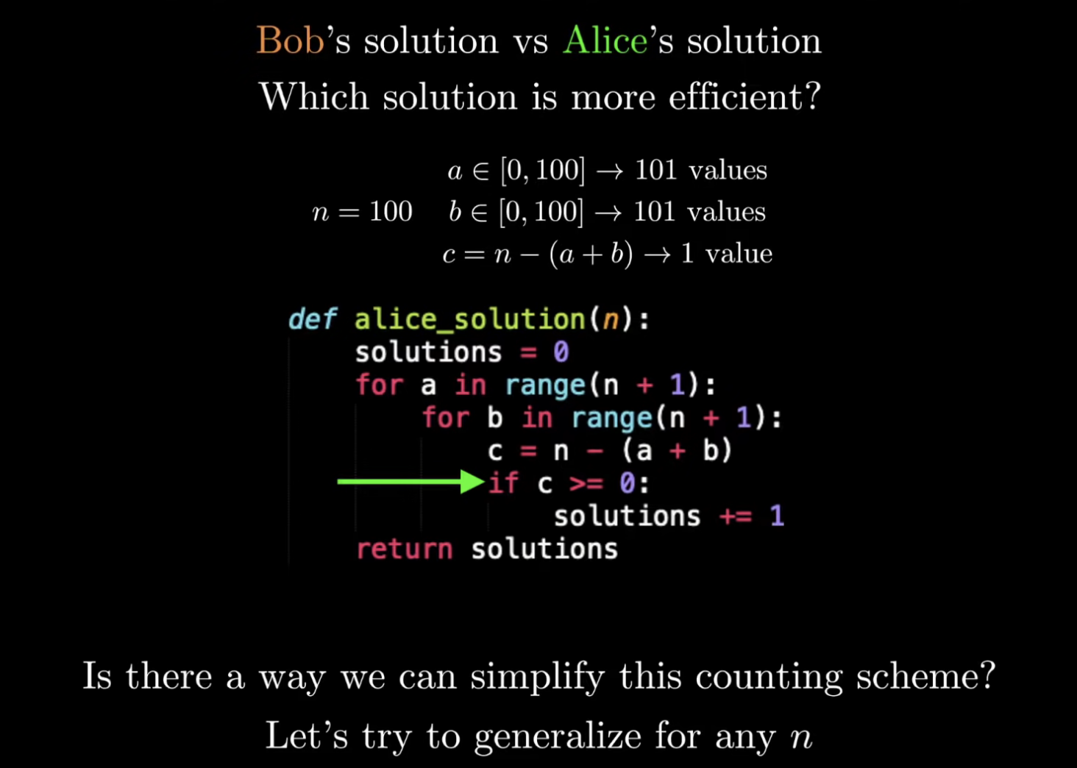
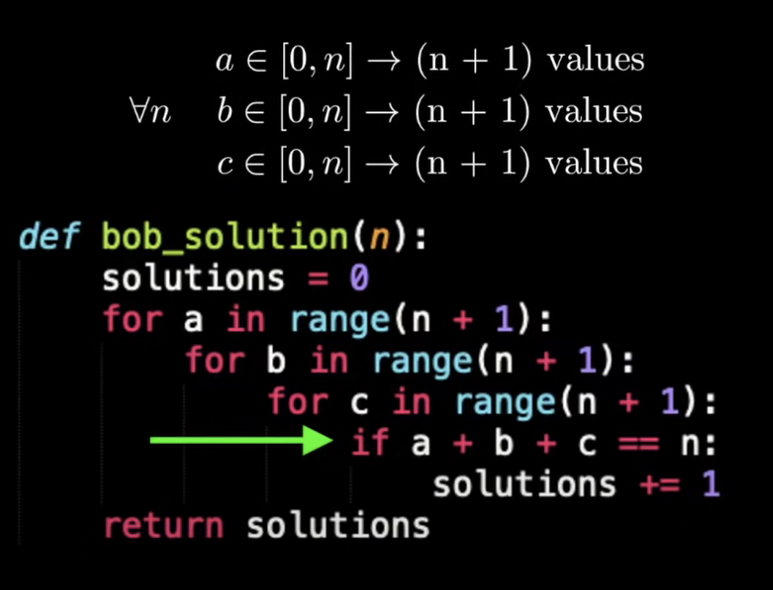
How to measure algorithm efficiency?
Instead of figuring out the count for specific n values, let’s generalize to any n.
Looking at Bob’s algorithm -
Image credit - Reducible @ YouTube

Slide 13
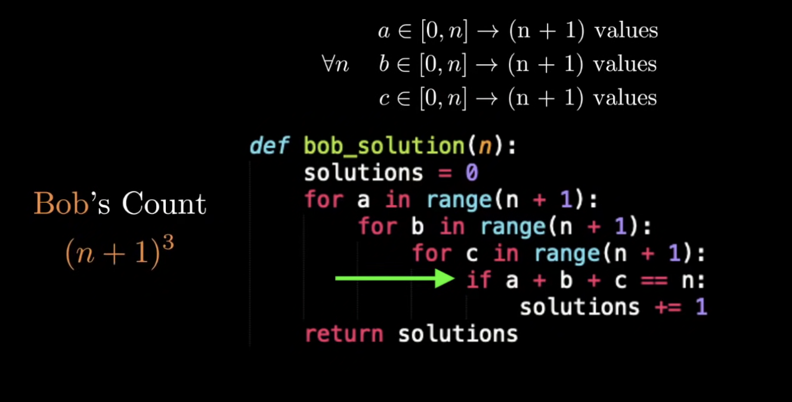
How to measure algorithm efficiency?
Instead of figuring out the count for specific n values, let’s generalize to any n.
Looking at Bob’s algorithm -
Image credit - Reducible @ YouTube

Slide 14
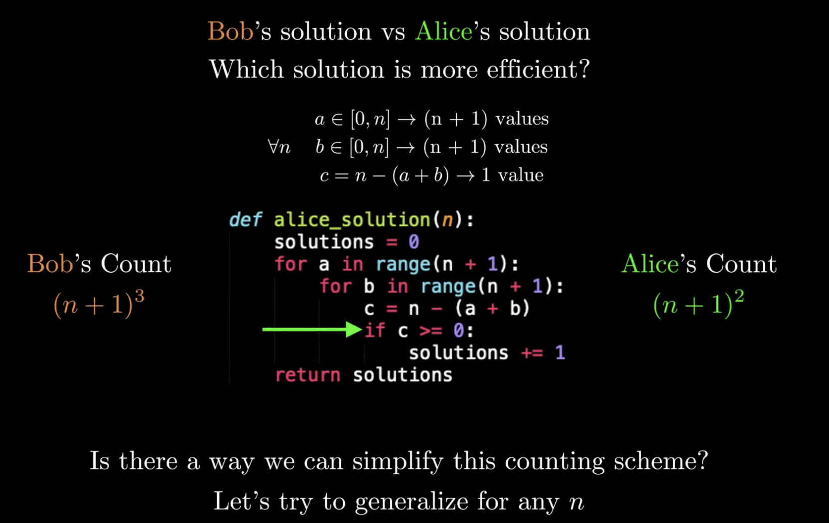
How to measure algorithm efficiency?
Alice’s algorithm has a similar generalized n count -
Image credit - Reducible @ YouTube

Slide 15
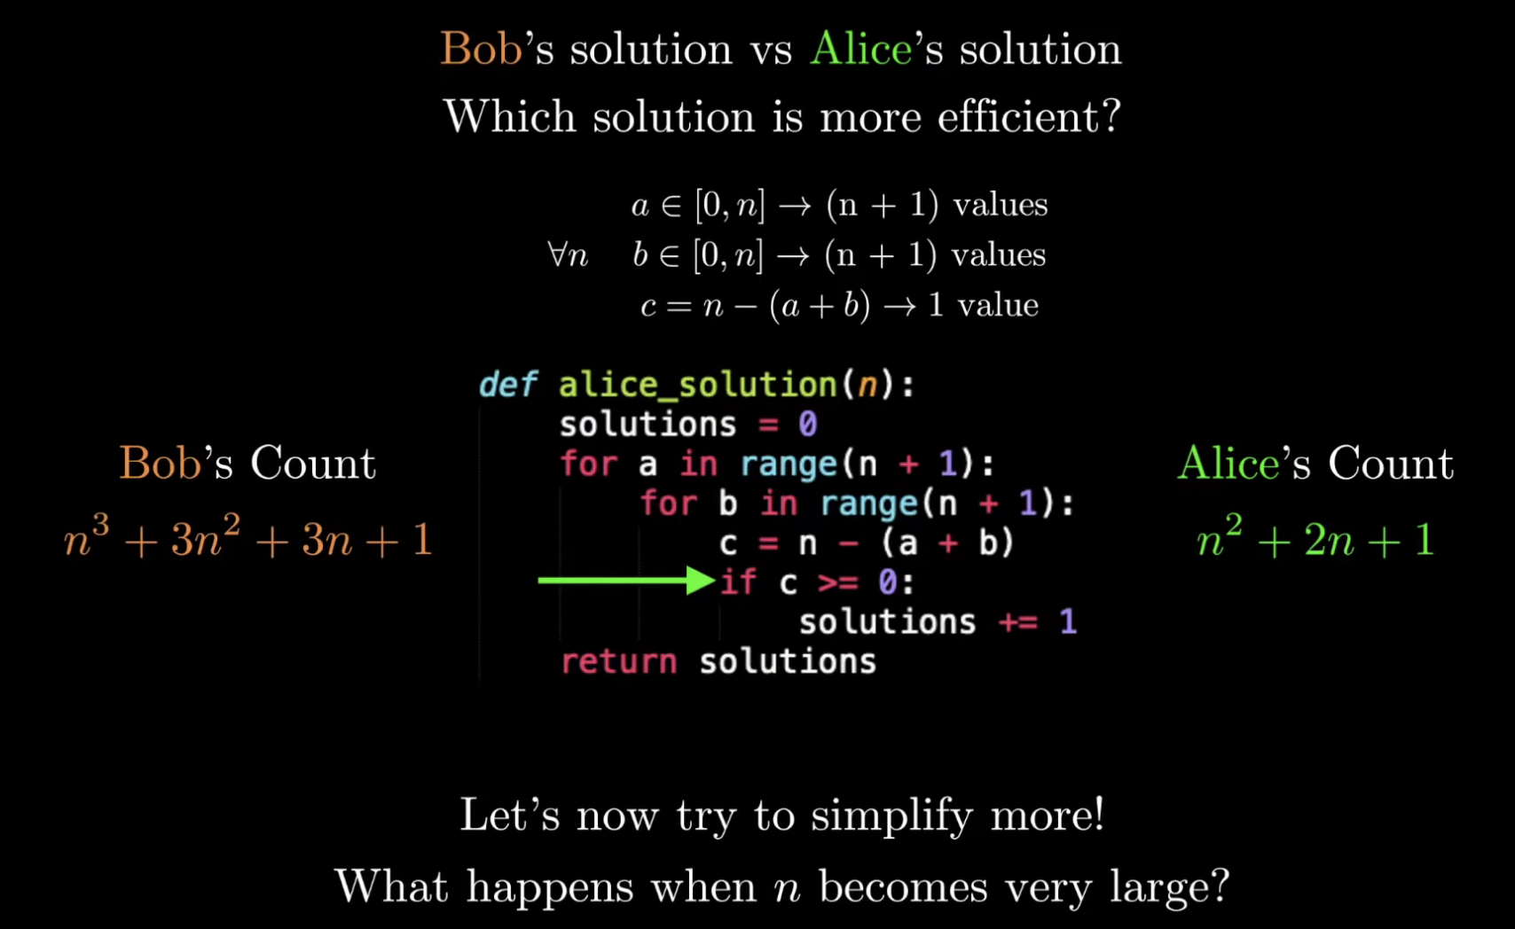
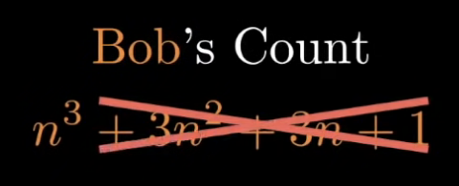
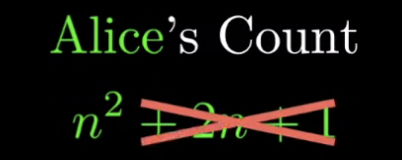
How to measure algorithm efficiency?
Now we have a general expression for how each algorithm operates for any n value.
If we are really concerned about how the program performs as the input grows, what we should really focus on is the worst-case performance when n is a very large number.
When n is very large, the lower order terms becomes so irrelevant that we can ignore them.
Image credit - Reducible @ YouTube

Slide 16
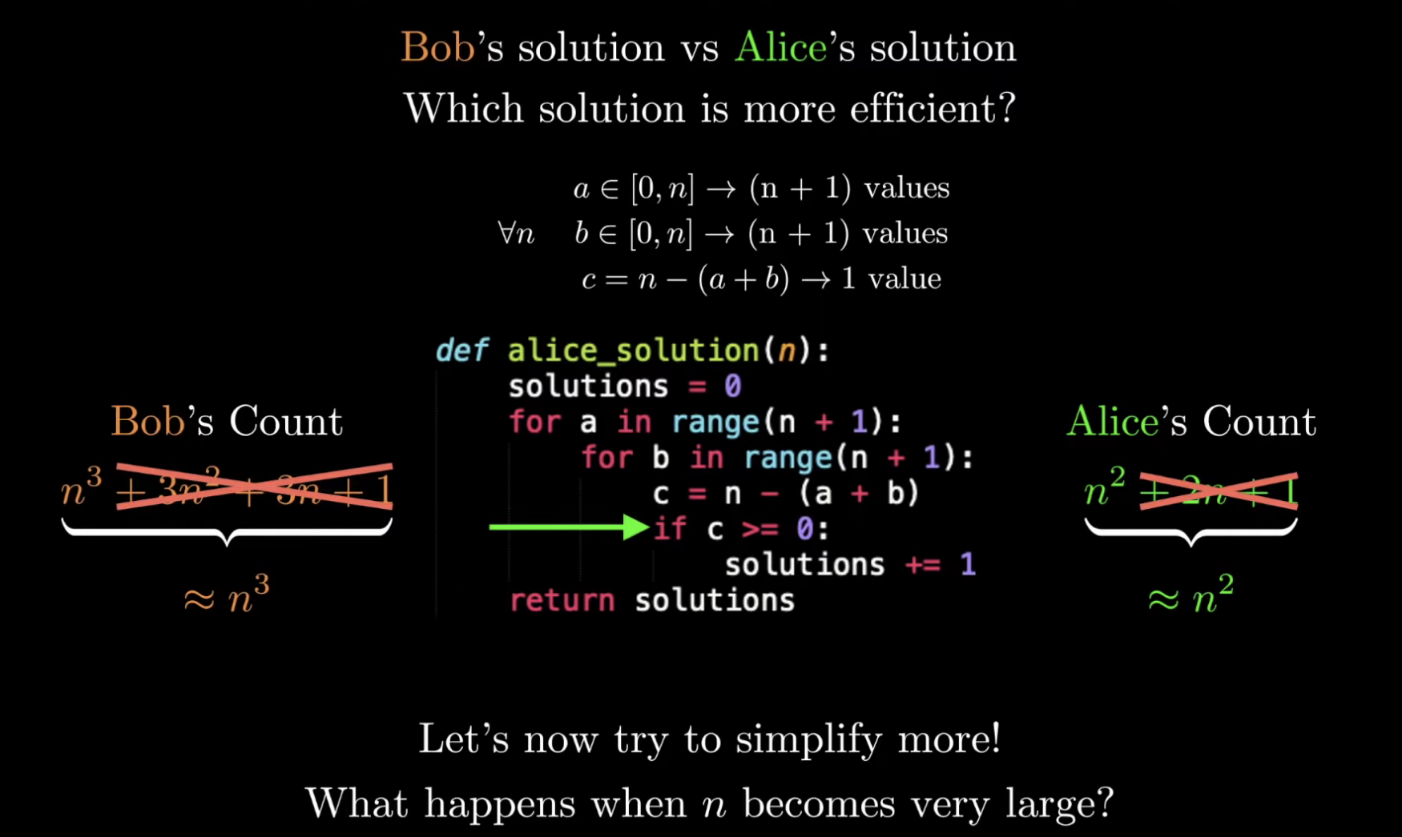
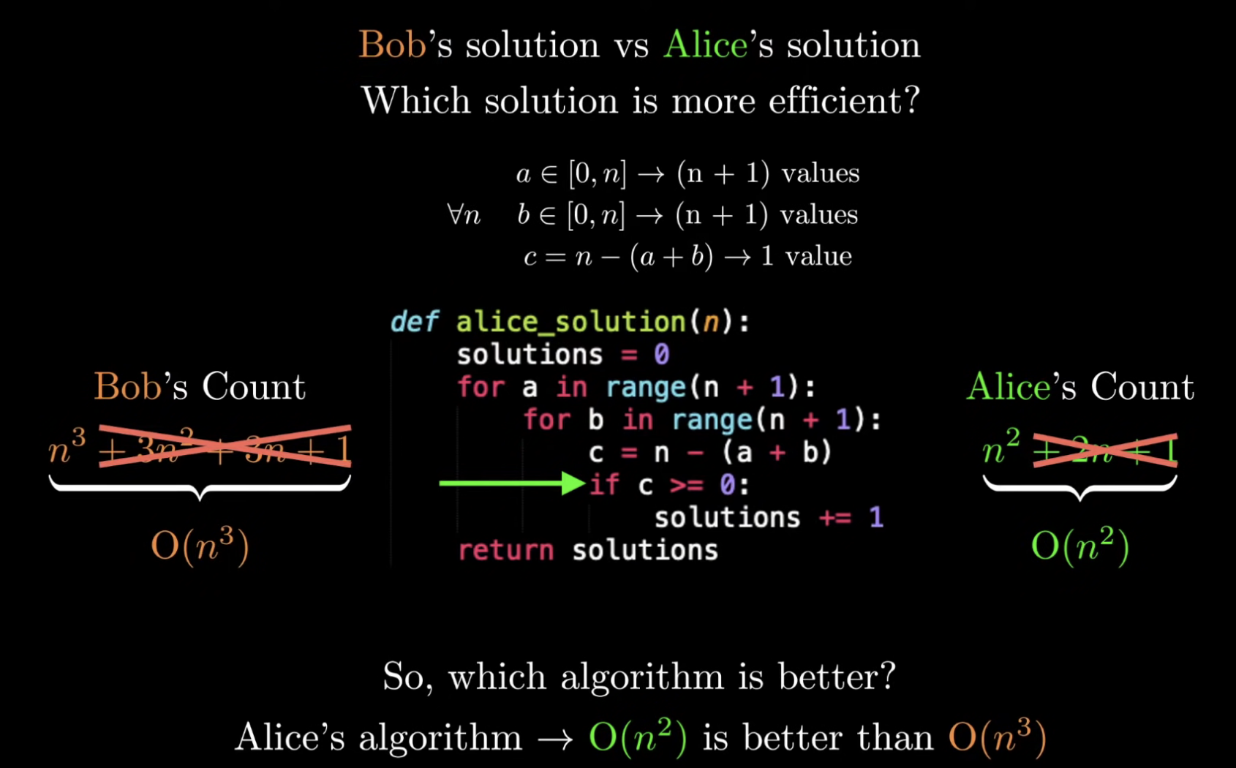
How to measure algorithm efficiency?
The final single term for each of this algorithm encapsulates the running time of an algorithm.
Now, we can definitively say that Alice’s program is better than Bob’s because it grows at a much slower pace compared to Bob’s.
Image credit - Reducible @ YouTube

Slide 17

Motivations for Complexity Analysis
There are often many different algorithms which can be used to solve the same problem. Thus, it makes sense to develop techniques that allow us to:
compare different algorithms with respect to their “efficiency”
choose the most efficient algorithm for the problem
The efficiency of any algorithmic solution to a problem is a measure of the:
Time efficiency: the time it takes to execute.
Space efficiency: the space (primary or secondary memory) it uses.
We will focus on an algorithm’s efficiency with respect to time.

Slide 18

Time and Space Complexity
Time complexity is defined as the amount of time taken by an algorithm to run, as a function of the length of the input.
It measures the time taken to execute each statement of code in an algorithm. It is not going to examine the total execution time of an algorithm. Rather, it is going to give information about the variation (increase or decrease) in execution time when the number of operations (increase or decrease) in an algorithm.
Yes, as the definition says,
the amount of time taken is a function of the length of input only.
When an algorithm is run on a computer, it necessitates a certain amount of memory space.
Space complexity of an algorithm quantifies the amount of space or memory taken by an algorithm to run as a function of the length of the input.
One major underlying factor affecting your program's performance and efficiency is the hardware, OS, and CPU you use.
But you don't consider this when you analyze an algorithm's performance. Instead, the time and space complexity as a function of the input's size are what matters.
Image credit - https://www.qapitol.com/

Slide 19
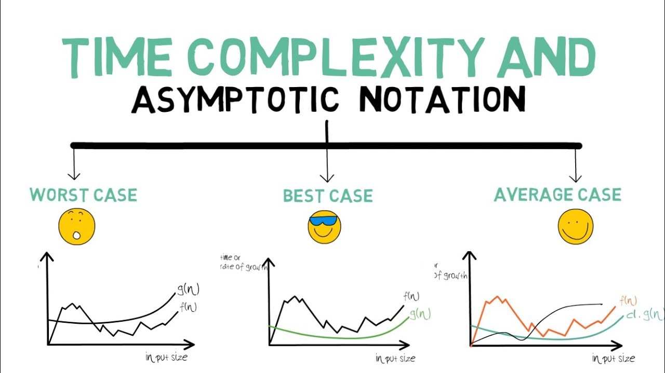
Asymptotic Notations
Asymptotic Notations are programming languages that allow you to analyze an algorithm's running time by identifying its behavior as its input size grows. This is also referred to as an algorithm's growth rate. When the input size increases, does the algorithm become incredibly slow? Is it able to maintain its fast run time as the input size grows?
You can answer these questions thanks to Asymptotic Notation.
You can't compare two algorithms head to head. It is heavily influenced by the tools and hardware you use for comparisons, such as the operating system, CPU model, processor generation, and so on. Even if you calculate time and space complexity for two algorithms running on the same system, the subtle changes in the system environment may affect their time and space complexity.
As a result, you compare space and time complexity using asymptotic analysis. It compares two algorithms based on changes in their performance as the input size is increased or decreased.
Asymptotic notations are classified into three types:
Big-Oh (O) notation
Big Omega ( Ω ) notation
Big Theta ( Θ ) notation
Image credit - https://www.boardinfinity.com/

Slide 20
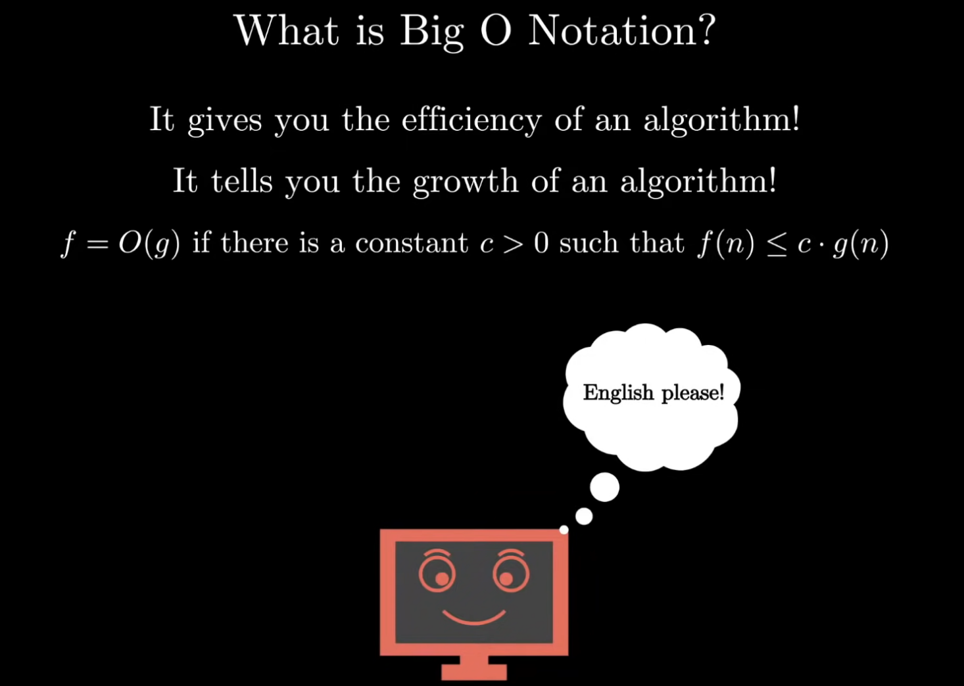
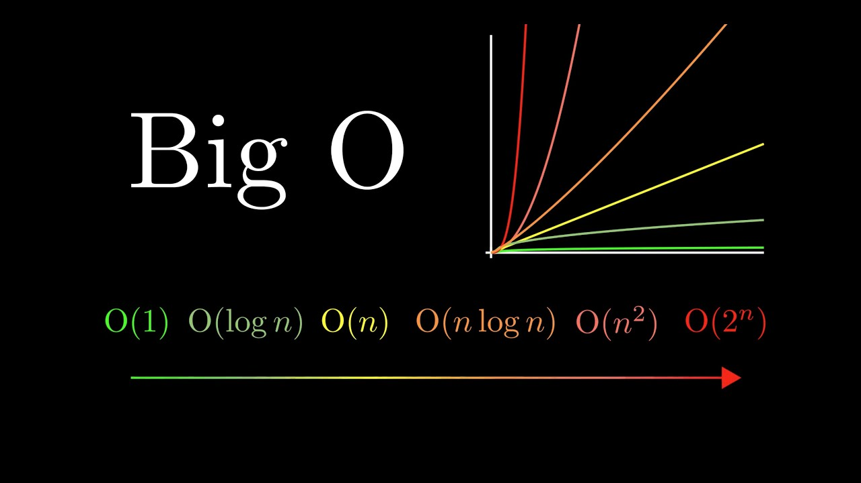
Asymptotic Notations
Big-O Notation
The Big-O notation describes the worst-case running time of a program.
We compute the Big-O of an algorithm by counting how many iterations an algorithm will take in the worst-case scenario with an input of N.
We typically consult the Big-O because we must always plan for the worst case. For example, O(log n) describes the Big-O of a binary search algorithm.
The common algorithmic runtimes from fastest to slowest are:
constant: Θ(1)
logarithmic: Θ(log N)
linear: Θ(N)
polynomial: Θ(N^2)
exponential: Θ(2^N)
factorial: Θ(N!)
Image credit - Reducible @ YouTube

Slide 21
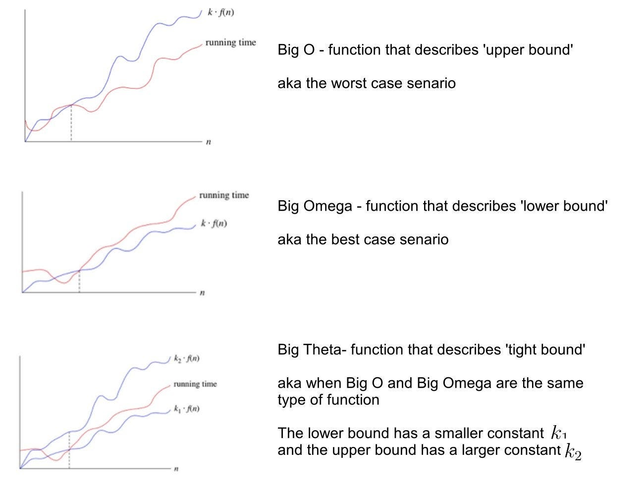
Asymptotic Notations
Big-Ω and Big-Θ Notation
Big-Ω (Omega) describes the best running time of a program.
We compute the big-Ω by counting how many iterations an algorithm will take in the best-case scenario based on an input of N.
For example, a Bubble Sort algorithm has a running time of Ω(N) because in the best case scenario the list is already sorted, and the bubble sort will terminate after the first iteration.
Big – Theta(Θ) notation specifies asymptotic bounds (both upper and lower) for a function f(n) and provides the average time complexity of an algorithm.
Image credit - https://blog.devgenius.io/

Slide 22
Asymptotic Notations
Big-Ω and Big-Θ Notation
Best, Worst, and Average
Big-Ω (Omega) describes the best running time of a program.
We compute the big-Ω by counting how many iterations an algorithm will take in the best-case scenario based on an input of N.
For example, a Bubble Sort algorithm has a running time of Ω(N) because in the best case scenario the list is already sorted, and the bubble sort will terminate after the first iteration.
Big – Theta(Θ) notation specifies asymptotic bounds (both upper and lower) for a function f(n) and provides the average time complexity of an algorithm.
We are usually interested in the worst case complexity: what are the most operations that might be performed for a given problem size. We will not discuss the other cases -- best and average case.
Best case depends on the input
Average case is difficult to compute
So we usually focus on worst case analysis
Easier to compute
Usually close to the actual running time
Crucial to real-time systems (e.g. air-traffic control)
Image credit - https://blog.devgenius.io/

Slide 23
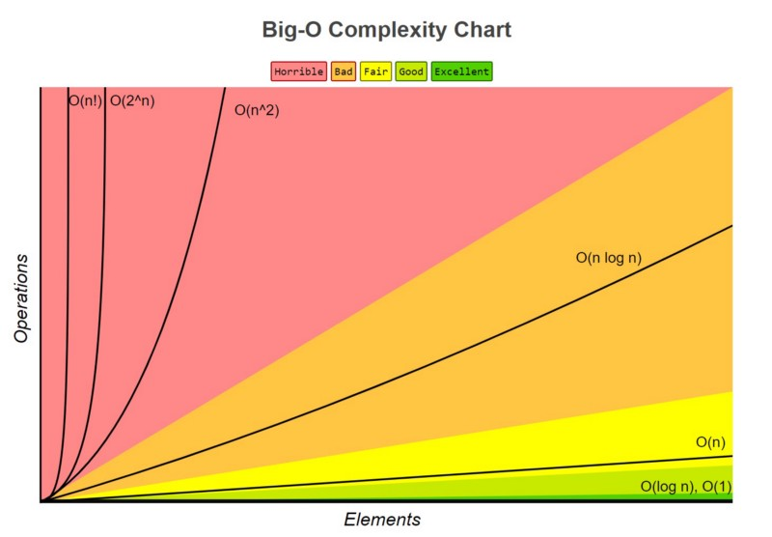
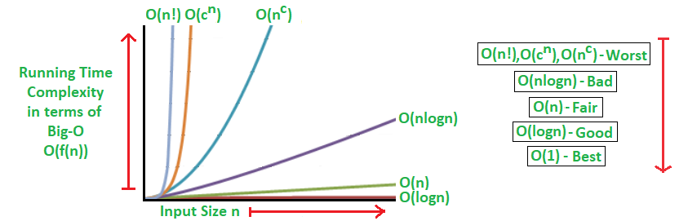
Big-O Notation
Big O notation is simplified analysis of an algorithm’s efficiency.
Big-O gives an algorithm’s complexity (amount of resources required to run it) in terms of input size, N
Machine-independent - we don’t care about the stats of the machine
We examine basic computer steps
Big-O can analyze both time & space complexity
The letter O was chosen by Bachmann to stand for Ordnung, meaning the order of approximation.
Image credit - https://www.freecodecamp.org/
General rules -
Ignore constants 5n → O(n) Because as n gets large, the 5 no longer matters
As n grows, certain terms “dominate” others O(1) < O(log n) < O(n) < O(nlogn) < O (n^2) < O(2^n) < O(n!) i.e., ignore low-order terms when they are dominated by high-order ones
Image credit - https://www.geeksforgeeks.org/

Slide 24
Big-O Notation
Basic Operations
Big O notation is simplified analysis of an algorithm’s efficiency.
Big-O gives an algorithm’s complexity (amount of resources required to run it) in terms of input size, N
Machine-independent - we don’t care about the stats of the machine
We examine basic computer steps
Big-O can analyze both time & space complexity
The letter O was chosen by Bachmann to stand for Ordnung, meaning the order of approximation.
Arithmetic operations: *, /, %, +, -
Assignment statements of simple data types.
Reading of primitive types
Writing of a primitive types
Simple conditional tests: if (x < 12) ...
method call (Note: the execution time of the method itself may depend on the value of parameter and it may not be constant)
a method's return statement
Memory Access
We consider an operation such as ++ , += , and *= as consisting of two basic operations.
Note: To simplify complexity analysis we will not consider memory access (fetch or store) operations.
Image credit - https://www.freecodecamp.org/
General rules -
Ignore constants 5n → O(n) Because as n gets large, the 5 no longer matters
As n grows, certain terms “dominate” others O(1) < O(log n) < O(n) < O(nlogn) < O (n^2) < O(2^n) < O(n!) i.e., ignore low-order terms when they are dominated by high-order ones
Image credit - https://www.geeksforgeeks.org/

Slide 25
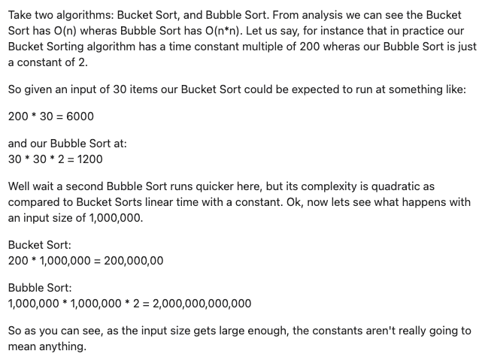
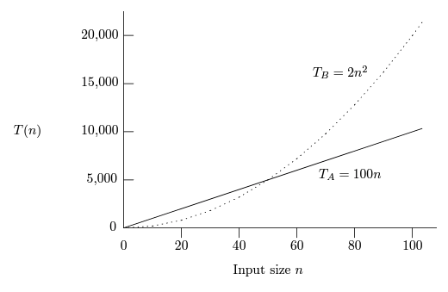
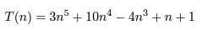
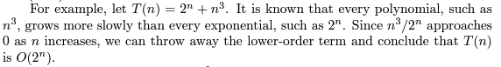
The general principles of computing Big-O are:
Constant factors don’t matter
Comparing Different Running Times
Suppose that for some problem we have the choice of using a linear-time program A whose running time is TA(n) = 100n and a quadratic-time program B whose running time is
TB(n) = 2n^2. Let us suppose that both these running times are the number of milliseconds taken on a particular computer on an input of size n.
Low order terms don’t matter
We see that for inputs of size less than 50, program B is faster than program A. When the input becomes larger than 50, program A becomes faster, and from that point on, the larger the input, the bigger the advantage A has over B. For inputs of size 100, A is twice as fast as B, and for inputs of size 1000, A is 20 times as fast.

Slide 26
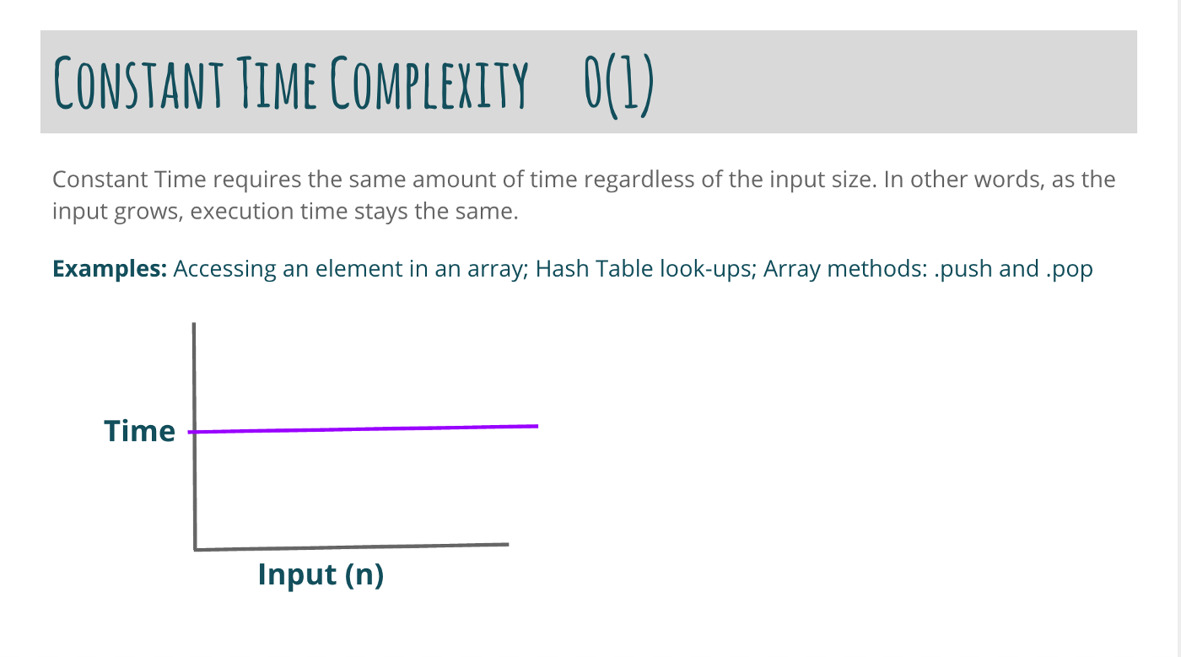
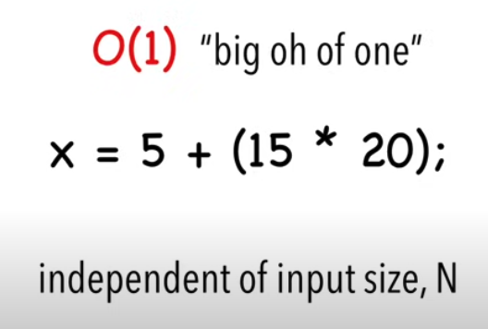
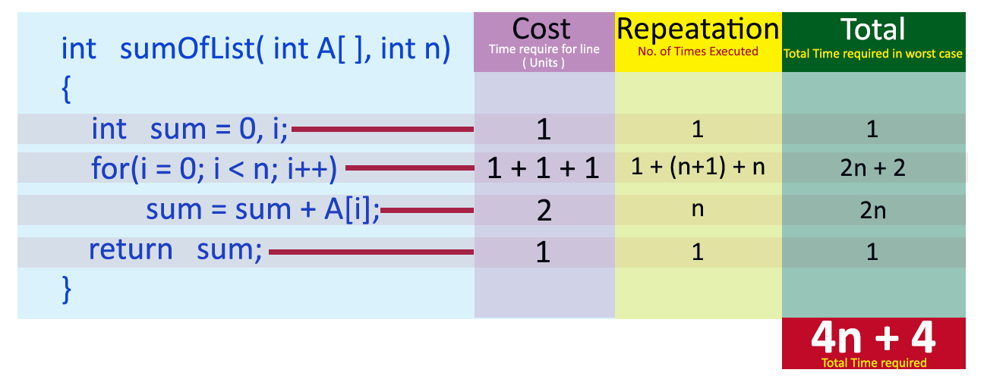
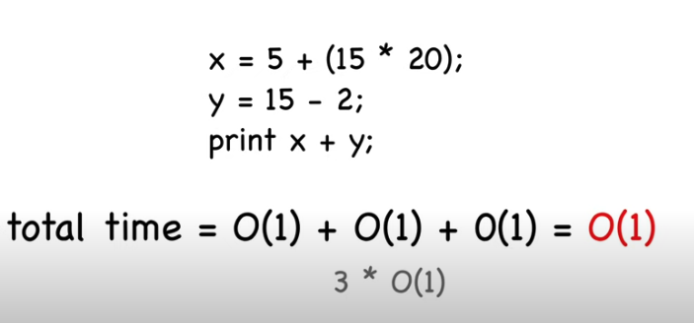
Big-O Notation: O(1)
Constant Time - Simple Statements
The algorithm performs a constant number of operations regardless of the size of the input.
Examples:
Access a single number in an array by index
Add 2 numbers together.
Image credit - Jacob Kagon @Medium
We drop constants so it’s still big-oh of one
Image credit - http://www.btechsmartclass.com/
Image credit - Michael Sambol

Slide 27
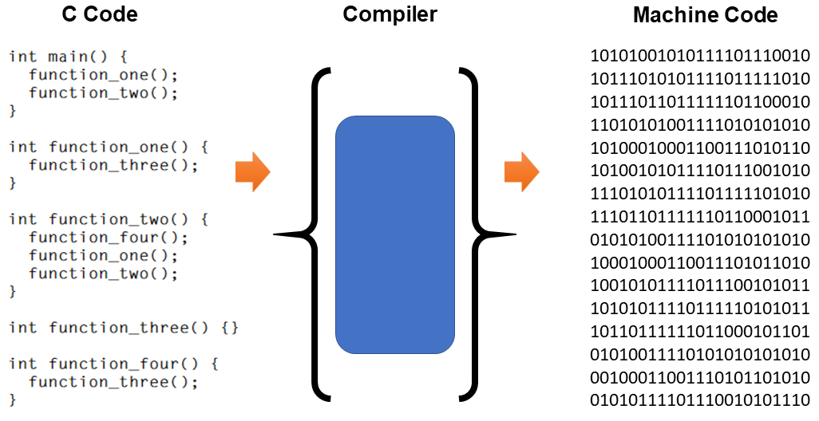
Big-O Notation: O(1)
Constant Time - Simple Statements
Certain simple operations on data can be done in O(1) time, that is, in time that is independent of the size of the input. These primitive operations in consist of:
Arithmetic operations (e.g. + or %).
Logical operations (e.g., &&).
Comparison operations (e.g., <=).
Structure accessing operations (e.g. array-indexing like A[i], or pointer following with the-> operator).
Simple assignment such as copying a value into a variable.
Calls to library functions (e.g., scanf, printf).
Simple statements that can be executed in O(1) time, that is, in some constant amount of time independent of input:
Assignment statements that do not involve function calls in their expressions.
Read statements.
Write statements that do not require function calls to evaluate arguments.
The jump statements break, continue, goto, and return expression, where expression does not contain a function call.
Image credit - https://www.astateofdata.com/

Slide 28
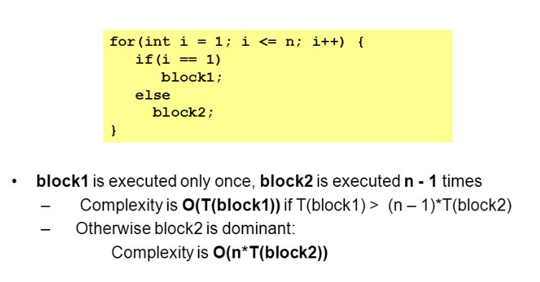
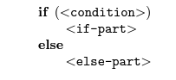
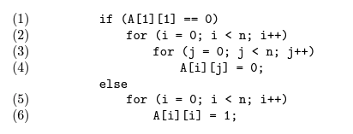
Big-O Notation: O(1)
Constant Time - Selection Statements
An if-else selection statement has the form
where
The condition is an expression to be evaluated,
The if-part is a statement that is executed only if the condition is true (the value of the expression is not zero), and
The else-part is a statement that is executed if the condition is false (evaluates to 0). The else followed by the <else-part> is optional.
A condition, no matter how complex, requires the computer to perform only a constant number of primitive operations, as long as there are no function calls within the condition.
Thus, the evaluation of the condition will take O(1) time.
Image credit - https://www.astateofdata.com/
The running time of lines (2) through (4) is O(n^2), while the running time of lines (5) and (6) is O(n). Thus, f(n) is n^2 here, and g(n) is n. Since n is O(n^2), we can neglect the time of the else-part and take O(n^2) as a bound on the running time of the entire fragment. That is to say, we have no idea if or when the condition of line (1) will be true, but the only safe upper bound results from assuming the worst: that the condition is true and the if-part is executed.

Slide 29
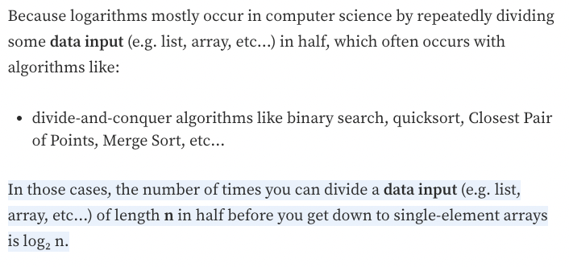
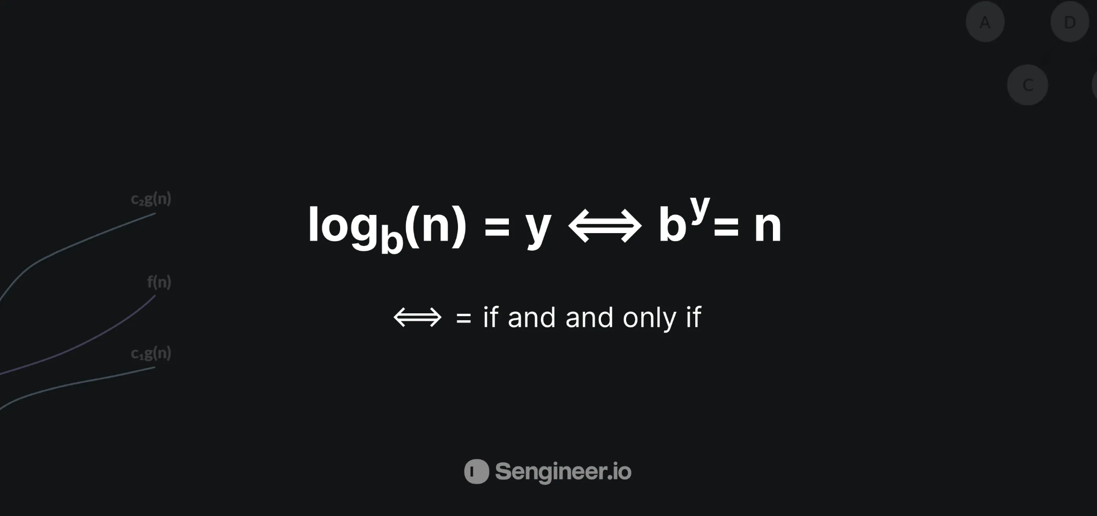
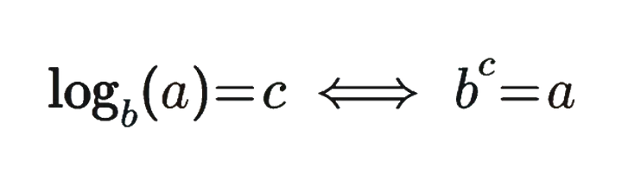
Big-O Notation: O(log n)
Logarithmic Time
How many times must a base of 20 be multiplied by itself to get 8,000? The answer is 3 (8000 = 20 × 20 × 20). So the logarithm base 20 of 8,000 is 3. It’s represented using a subscript (small number) to the lower right of the base number. So the statement would be log20(8,000) = 3.
log20(400) is like asking “How many 20s do we multiply to get 400? which is 2(20 * 20). So log20(400) = 2
Logarithms are defined using the following equation:
Image credit - Humam Abo Alraja @ Medium

Slide 30
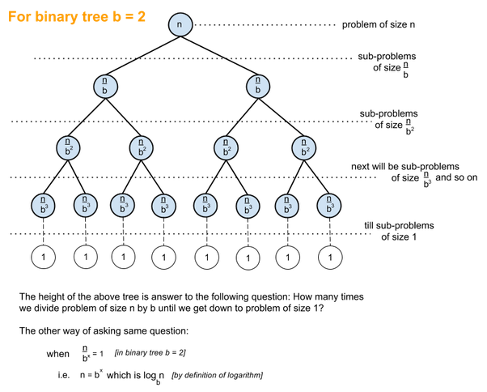
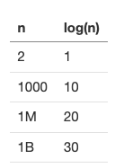
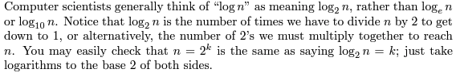
Big-O Notation: O(log n)
Logarithmic Time
As the size of input n increases, the algorithm's running time grows by log(n). This rate of growth is relatively slow, so O(log n) algorithms are usually very fast. As you can see in the table below, when n is 1 billion, log(n) is only 30.
Examples:
Binary search on a sorted list. The size that needs to be searched is split in half each time, so the remaining list goes from size n to n/2 to n/4... until either the element is found or there's just one element left. If there are a billion elements in the list, it will take a maximum of 30 checks to find the element or determine that it is not on the list.
Whenever an algorithm only goes through part of its input, see if it splits the input by at least half on average each time, which would give it a logarithmic running time.
Image credit - Sumod Mathilakath @ Quora

Slide 31
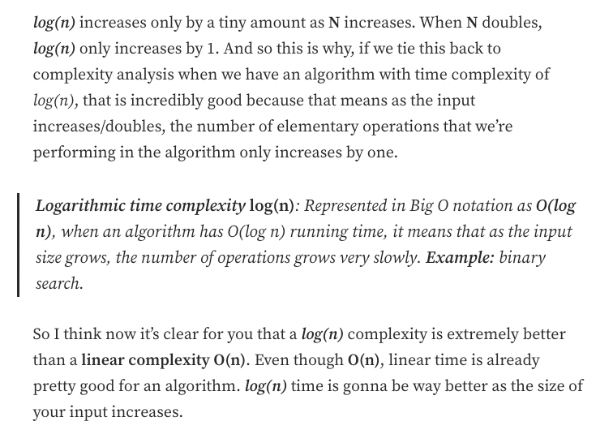
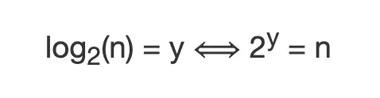
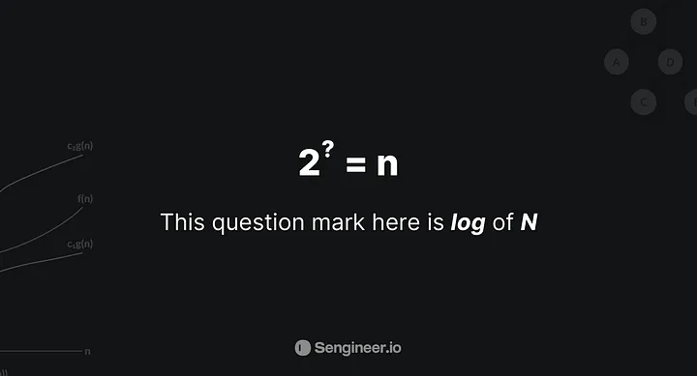
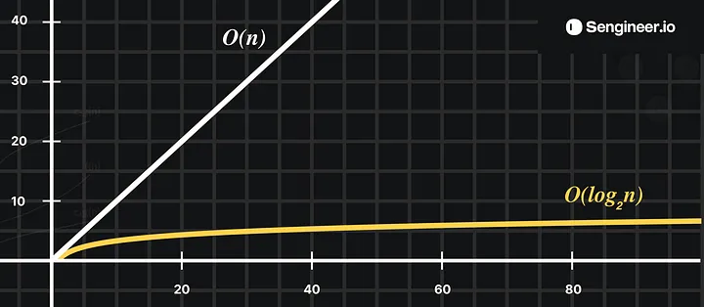
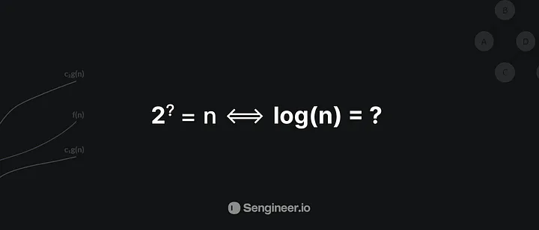
Big-O Notation: O(log n)
Logarithmic Time
So logarithm base 2 of n would be equal to y if and only if the number 2 to the power of y were equal to n.
Image credit - Humam Abo Alraja @ Medium

Slide 32
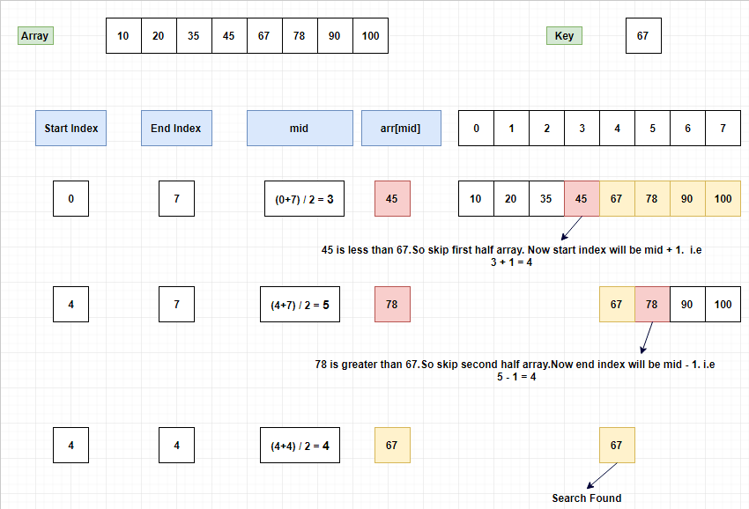
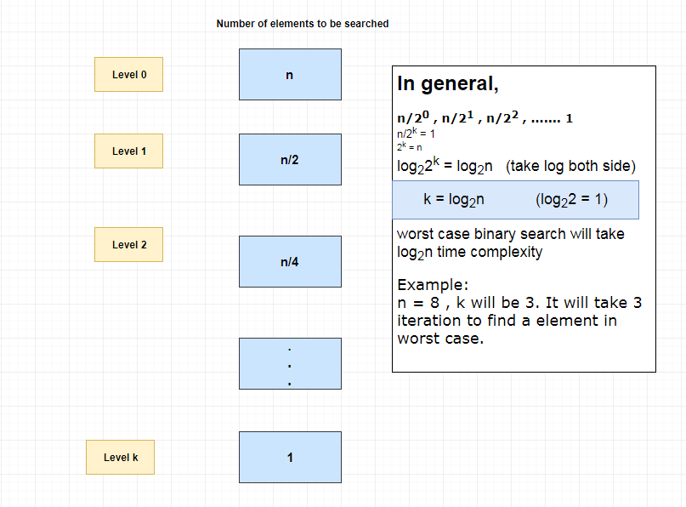
Big-O Notation: O(log n)
Logarithmic Time (Binary Search)
Image credit - https://www.log2base2.com/
O(log N) basically means time goes up linearly while the n goes up exponentially. So if it takes 1 second to compute 10 elements, it will take 2 seconds to compute 100 elements, 3 seconds to compute 1000 elements, and so on.
​It is O(log n) when we do divide and conquer type of algorithms e.g binary search. Another example is quicksort where each time we divide the array into two parts and each time it takes O(N) time to find a pivot element. Hence it N O(log N)

Slide 33


Big-O Notation: O(log n)
Logarithmic Time
Step 1: i = k = k * m^0
Step 2: i = k * m = k * m^1
Step 3: i = k * m * m = k * m^2
Step 4: i = k * m * m * m = k * m^3
Let’s assume, i = n (when loop terminates) at step s
Step s i = n = k * m^(s-1) => (n/k) = m^(s-1)
Apply log base m on both sides
log (n/k) = (s-1) => s = log (n/k) + 1
Therefore, number of steps ≈ O (log n/k) (base m)
Step 1: i = 1 * 2 = 2 = 2^1
Step 2: i = 2 * 2 = 4 = 2^2
Step 3: i = 4 * 2 = 8 = 2^3
Step 4: i = 8 * 2 = 16 = 2^4
Let’s assume, i = n+1 (when loop terminates) at step k
Step k i = n+1 = 2^k
Apply log base 2 on both sides
log (n+1) = log (2^k) => k = log (n+1)
Therefore, number of steps ≈ O (log n) (base 2)

Slide 34




Big-O Notation: O(n)
Linear Time - Simple For Loops
The running time of an algorithm grows in proportion to the size of input.Following for loop prints the number from 0 to n:
Examples:
Search through an unsorted array for a number
Sum all the numbers in an array
Access a single number in a LinkedList by index
During the summation, we drop low-order term. When n gets large, the time it takes to compute the value of y is meaningless.
In this example, the for loop dominates the run time.
Image credit - Michael Sambol
Image credit - https://scienceaid.net/

Slide 35


Big-O Notation: O(n log n)
Linearithmic Time
Linearithmic runtime refers to an algorithm whose time complexity grows in a near-linear fashion with the size of the input data.
Algorithms with linearithmic runtime are faster than those with quadratic (O(n^2)) or cubic (O(n^3)) runtimes but slower than linear (O(n)) algorithms.
Linearithmic algorithms are commonly used in sorting and searching tasks, divide-and-conquer algorithms, and various tree-based data structures like balanced binary search trees.
Image credit - https://towardsdatascience.com/
Examples:
Sort an an array with QuickSort or Merge Sort. When recursion is involved, calculating the running time can be complicated. You can often work out a sample case to estimate what the running time will be.

Slide 36




Big-O Notation: O(n^2)
Quadratic Time
Anatomy of Nested Loops
Sometimes you'll encounter O(n^3) algorithms or even higher exponents. These usually have considerably worse running times than O(n^2) algorithms even if they don't have a different name!
The algorithm's running time grows in proportion to the square of the input size, and is common when using nested-loops. Here is a nested loop, which will be executed n x n:
A Quadratic running time is common when you have nested loops. To calculate the running time, find the maximum number of nested loops that go through a significant portion of the input.
1 loop (not nested) = O(n)
2 loops = O(n^2)
3 loops = O(n^3)
Image credit - Michael Sambol
Some algorithms use nested loops where the outer loop goes through an input n while the inner loop goes through a different input m. The time complexity in such cases is O(nm). For example, while the above multiplication table compared a list of data to itself, in other cases you may want to compare all of one list n with all of another list m.
Examples:
Printing the multiplication table for a list of numbers
Insertion Sort

Slide 37

Big-O Notation: O(n^2)
Quadratic Time
Image credit - Nemanja Žunić @ Medium

Slide 38



Big-O Notation: O(n^2)
Nested For Loops
Many for-loops are formed by initializing an index variable to some value and incrementing that variable by 1 each time around the loop. The for-loop ends when the index reaches some limit.
The outer for-loop below uses index variable i. It increments i by 1 each time around the loop, and the iterations stop when i reaches n−1.
We know that line (4) takes O(1) time. Clearly, we go around the loop n times, as we can determine by subtracting the lower limit from the upper limit found on line (3) and then adding 1. Since the body, line (4), takes O(1) time, we can neglect the time to increment j and the time to compare j with n, both of which are also O(1). Thus, the running time of lines (3) and (4) is the product of n and O(1), which is O(n).
Strictly speaking, we must then add O(1) time to initialize the loop index and O(1) time for the first comparison of the loop index with the limit, because we test one more time than we go around the loop. However, unless it is possible to execute the loop zero times, the time to initialize the loop and test the limit once is a low-order term that can be dropped by the summation rule.
For simple for loops, the difference between the final and initial values, divided by the amount by which the index variable is incremented tells us how many times we go around the loop. That count is exact, unless there are ways to exit the loop via a jump statement; it is an upper bound on the number of iterations in any case. For instance, the for-loop in the first line iterates (n − 1) − 0/1 = n − 1 times, since 0 is the initial value of i,
n − 1 is the highest value reached by i (i.e., when i reaches n−1, the loop stops and no iteration occurs with i = n−1), and 1 is added to i at each iteration of the loop.
We have already established that the loop of lines (3) and (4) takes O(n) time. Thus, we can neglect the O(1) time to increment i and to test whether i < n in each iteration, concluding that each iteration of the outer loop takes O(n) time. The initialization i = 0 of the outer loop and the (n + 1)st test of the condition i <n likewise take O(1) time and can be neglected. Finally, we observe that we go around the outer loop n times, taking O(n) time for each iteration, giving a total O(n^2) running time.

Slide 39



Big-O Notation: O(2^n)
Exponential Time
An exponential-time algorithm is one whose running time grows as an exponential function of the size of its input.
Examples:
Trying out every possible binary string of length n. (E.g. to crack a password).
Exponential is worse than polynomial.
O(n^2) falls into the quadratic category, which is a type of polynomial (the special case of the exponent being equal to 2) and better than exponential.
Exponential is much worse than polynomial.

Slide 40


Big-O Notation: O(n!)
Factorial Time
This algorithm's running time grows in proportion to n!, a really large number. O(n!) becomes too large for modern computers as soon as n is greater than 15+ (or upper teens). This issue shows up when you try to solve a problem by trying out every possibility, as in the traveling salesman problem.
Examples:
Go through all Permutations of a string
Traveling Salesman Problem (brute-force solution) Traveling Salesman has a naive solution that's O(n!), but it has a dynamic programming solution that's O(n^2 * 2^n)
Image credit - https://www.codecademy.com/

Slide 41


Time Complexities
Comparison Table
Image credit - https://en.wikipedia.org/

Slide 42




Calculating Time Complexity
More Examples
Image credit - Neso Academy
Loop here executes n/2 times, but if we take the least upper bound, we get O(n).

Slide 43




Calculating Time Complexity
More Examples
Image credit - Neso Academy

Slide 44




Calculating Time Complexity
More Examples
Image credit - https://academyera.com/
Image credit - EDULINE CSE KNOWLEDGE SHARING PLATFORM
Image credit - Dr. Jicheng Fu Department of Computer Science University of Central Oklahoma

Slide 45




Big-O Performance Comparisons
Image credit - https://craftofcoding.wordpress.com/
Image credit - https://javaconceptoftheday.com/
Image credit - https://www.sahinarslan.tech/
Image credit - https://www.ml-science.com/

Slide 46

Big-O Performance Comparisons
Image credit - https://www.hackerearth.com/

Slide 47

Big-O Performance Comparisons
Image credit - https://www.hackerearth.com/

Slide 48

Big-O Performance Comparisons
Image credit - https://www.hackerearth.com/

Slide 49


Big-O Performance Comparisons
Image credit - https://www.hackerearth.com/

